Slide 1

COPYRIGHT 숭신고 김강석 All rights reserved.

Slide 2
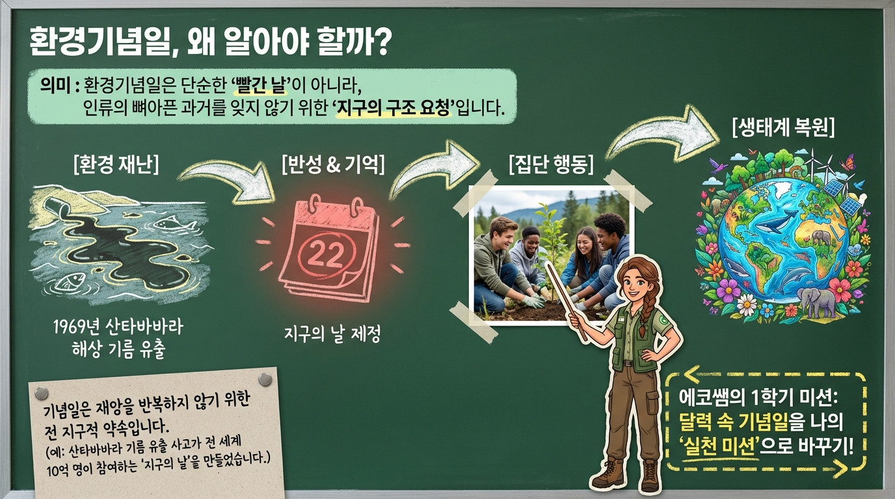
COPYRIGHT 숭신고 김강석 All rights reserved.

Slide 3
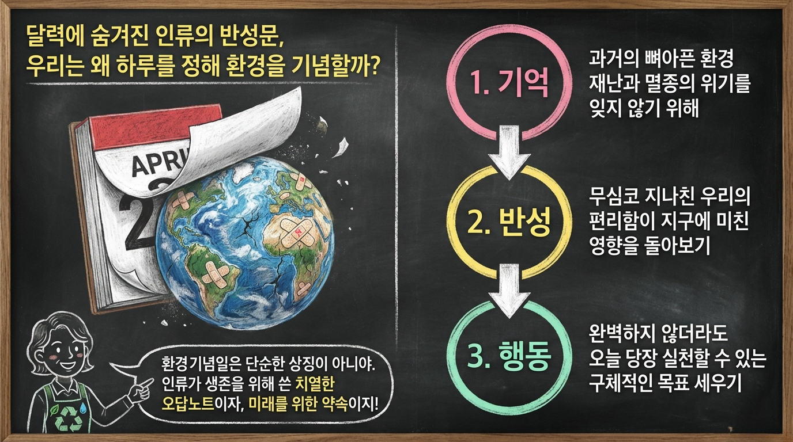
COPYRIGHT 숭신고 김강석 All rights reserved.

Slide 4
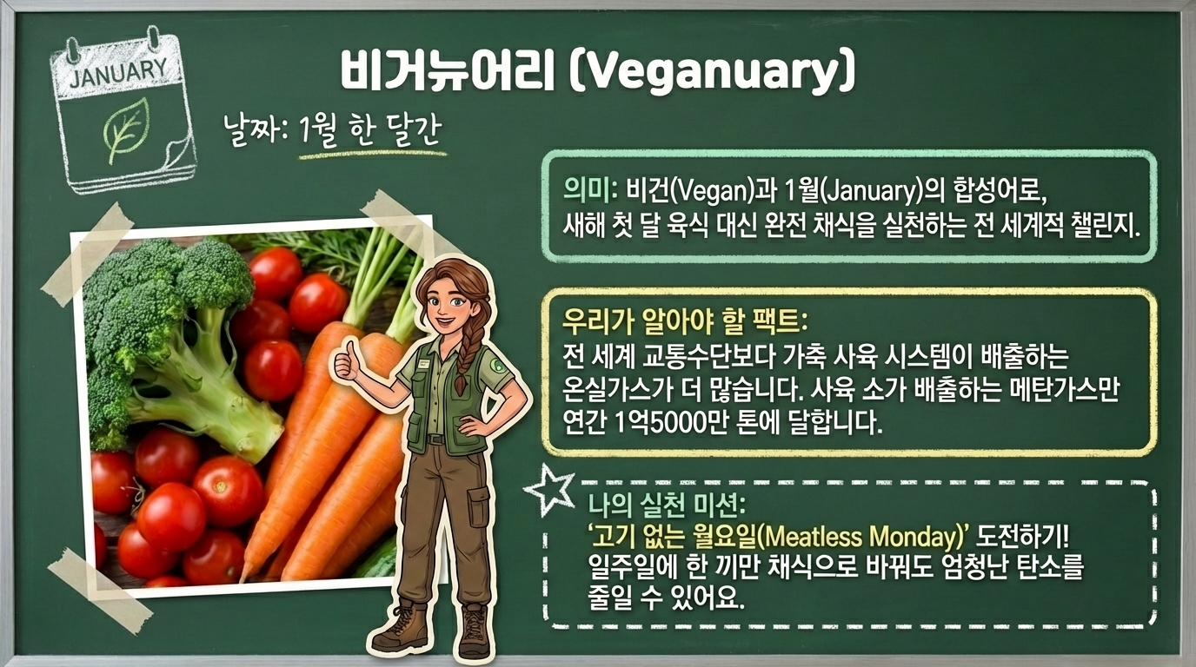
COPYRIGHT 숭신고 김강석 All rights reserved.

Slide 5
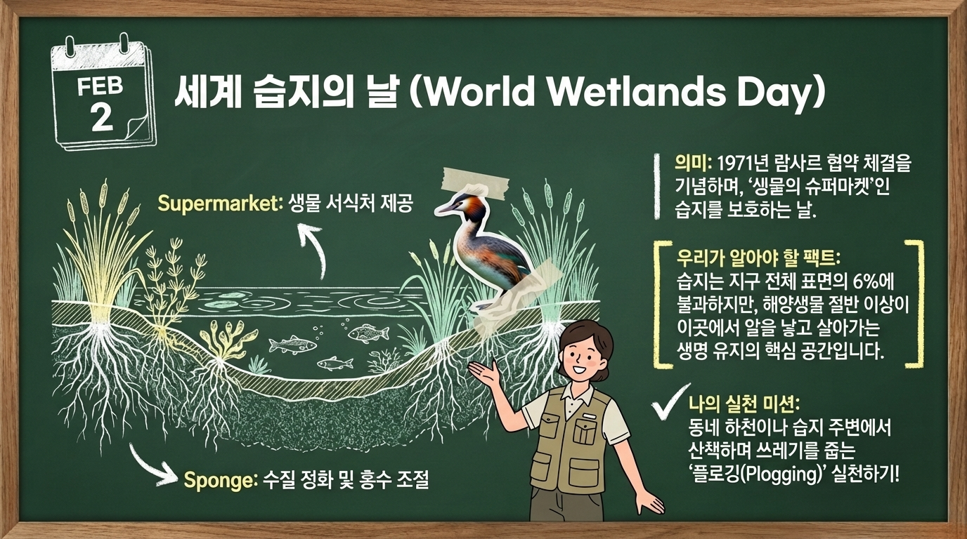
COPYRIGHT 숭신고 김강석 All rights reserved.

Slide 6
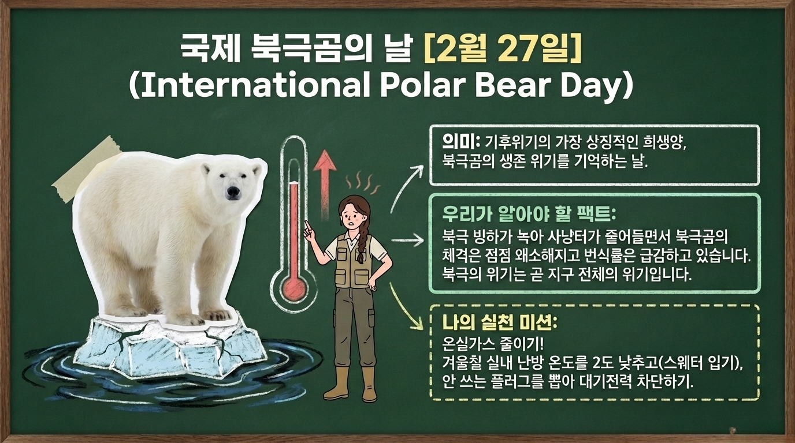
COPYRIGHT 숭신고 김강석 All rights reserved.

Slide 7
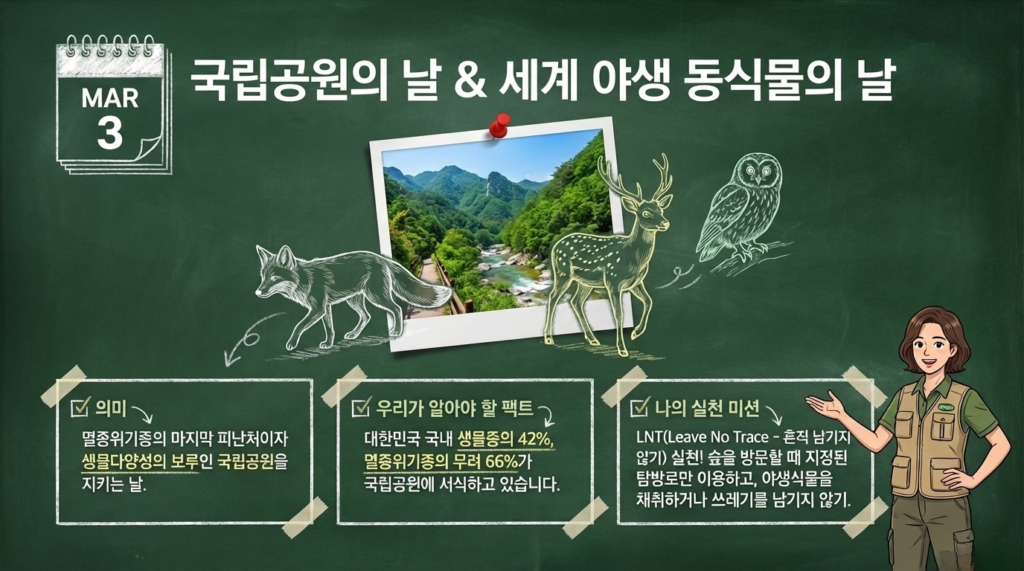
COPYRIGHT 숭신고 김강석 All rights reserved.

Slide 8
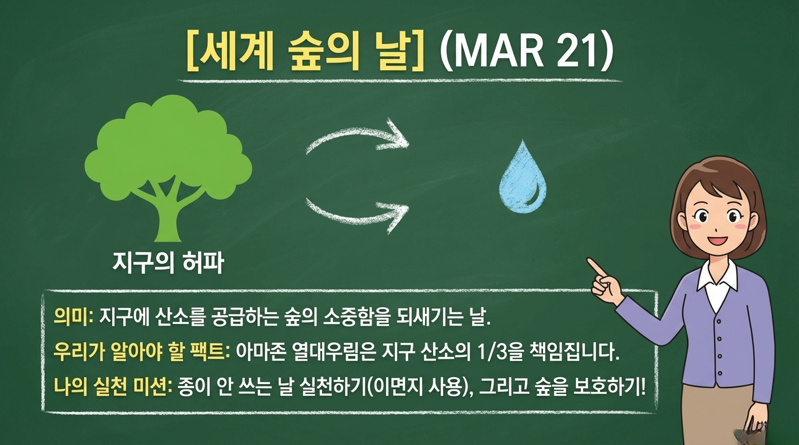
COPYRIGHT 숭신고 김강석 All rights reserved.

Slide 9
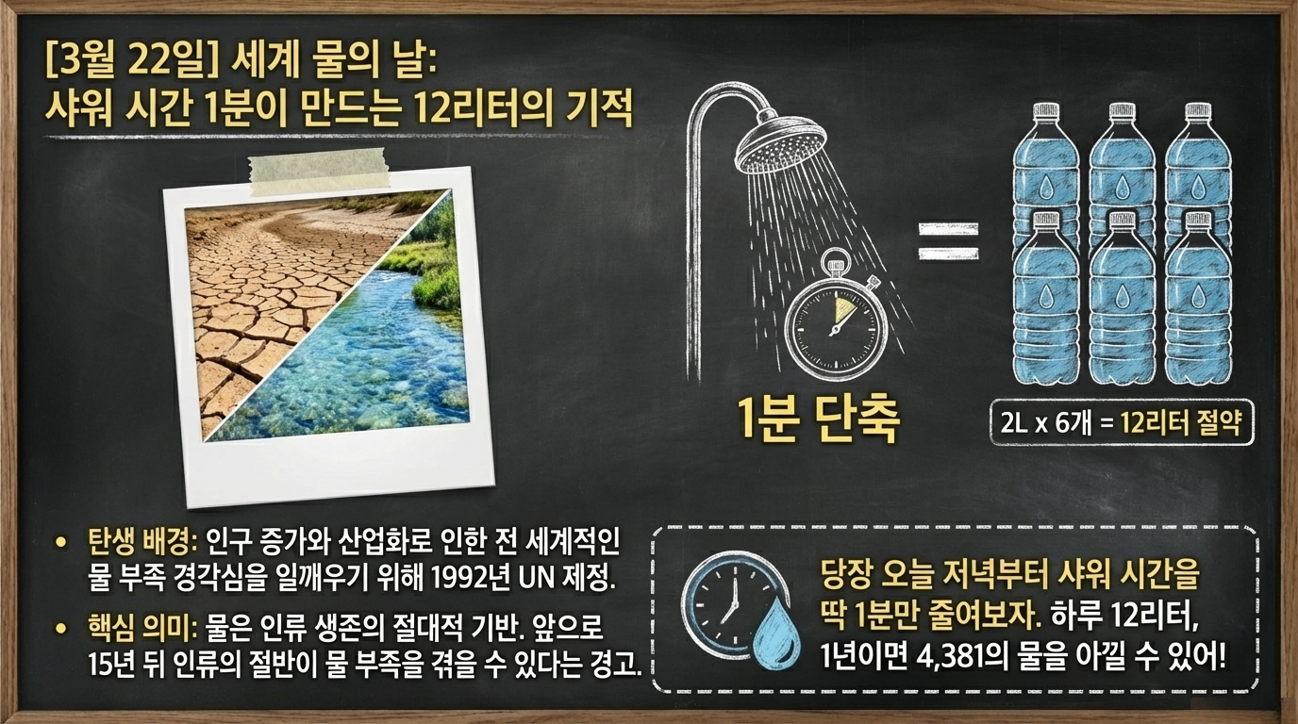
COPYRIGHT 숭신고 김강석 All rights reserved.

Slide 10
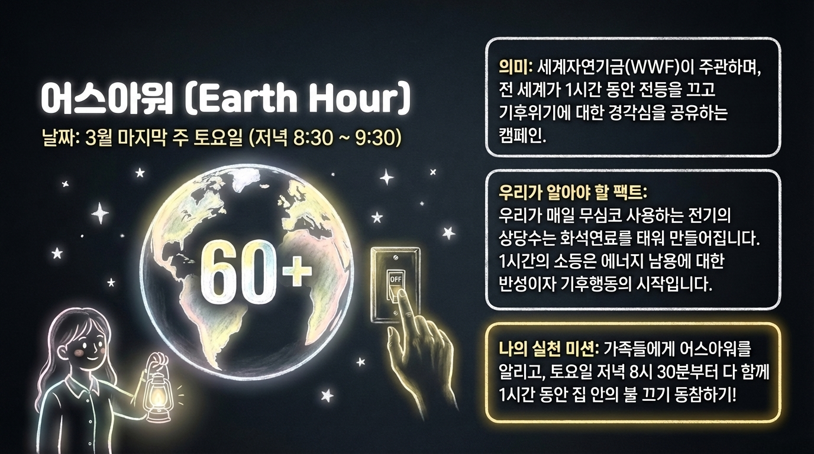
COPYRIGHT 숭신고 김강석 All rights reserved.

Slide 11
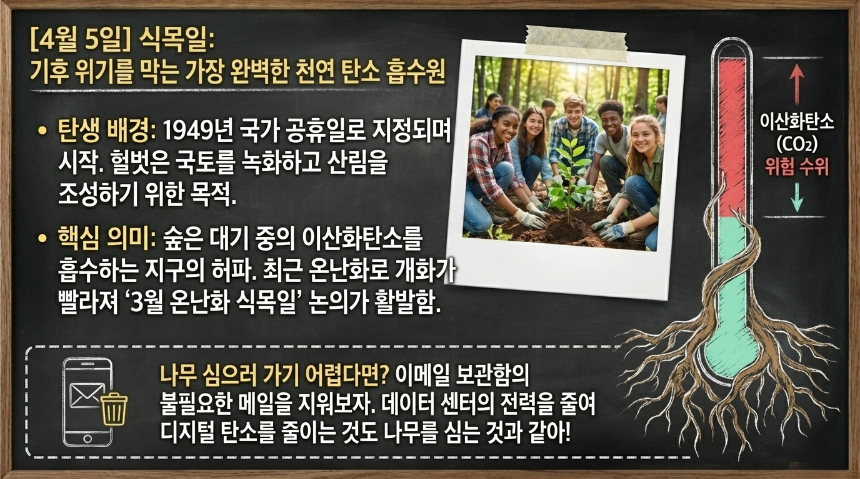
COPYRIGHT 숭신고 김강석 All rights reserved.

Slide 12
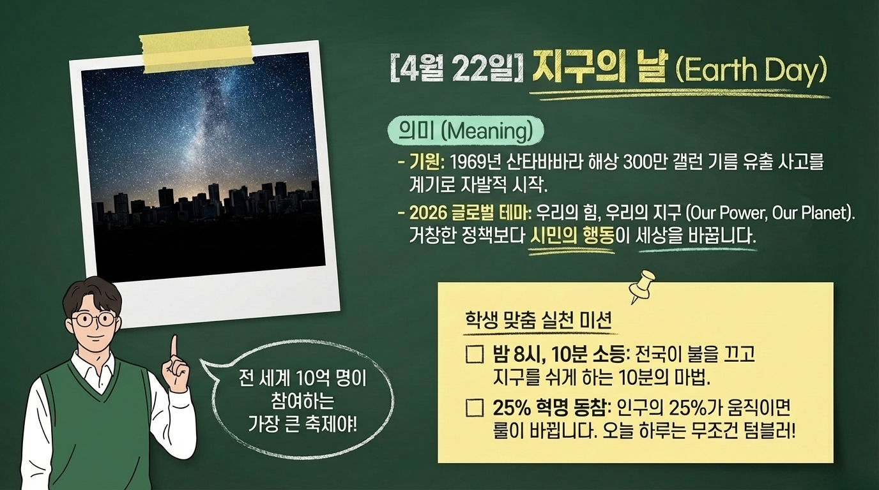
COPYRIGHT 숭신고 김강석 All rights reserved.

Slide 13
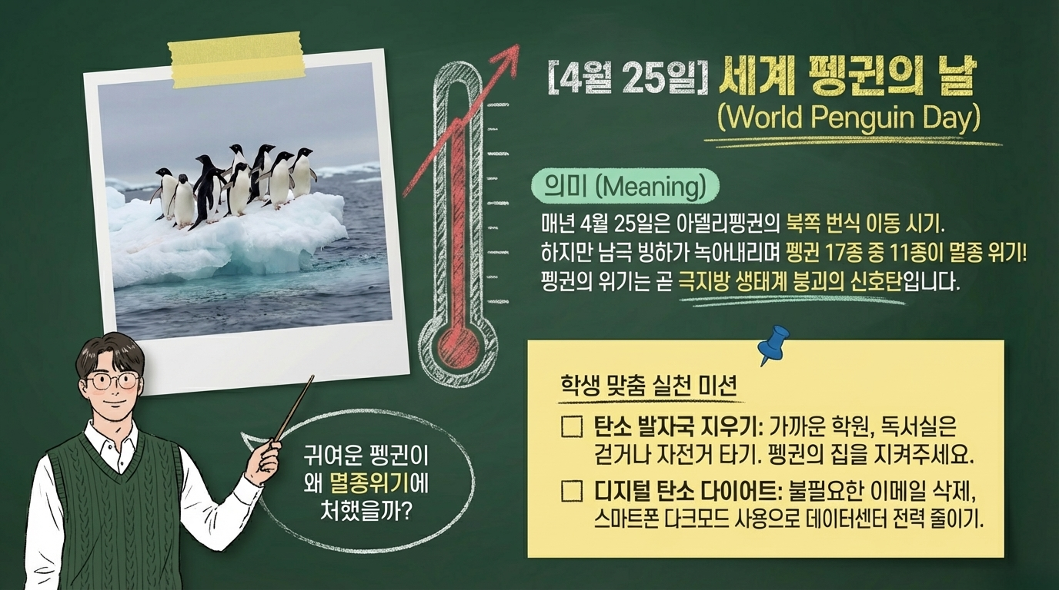
COPYRIGHT 숭신고 김강석 All rights reserved.

Slide 14
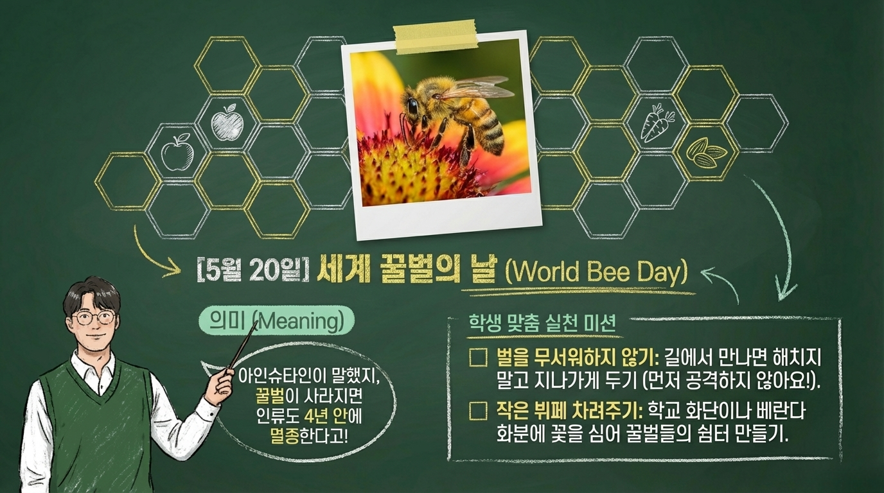
COPYRIGHT 숭신고 김강석 All rights reserved.

Slide 15
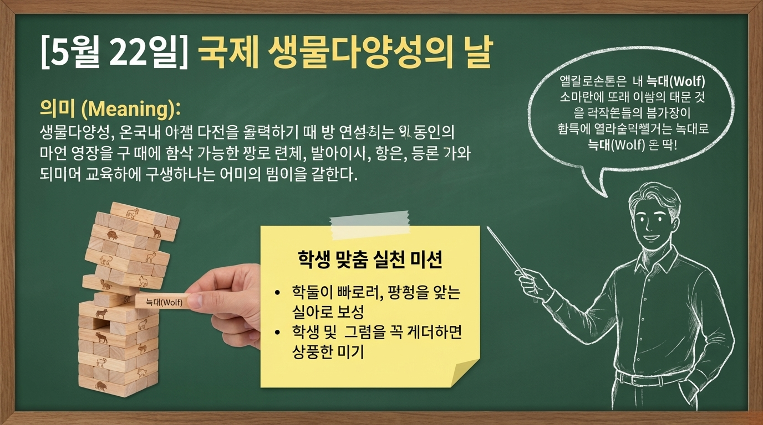
COPYRIGHT 숭신고 김강석 All rights reserved.

Slide 16
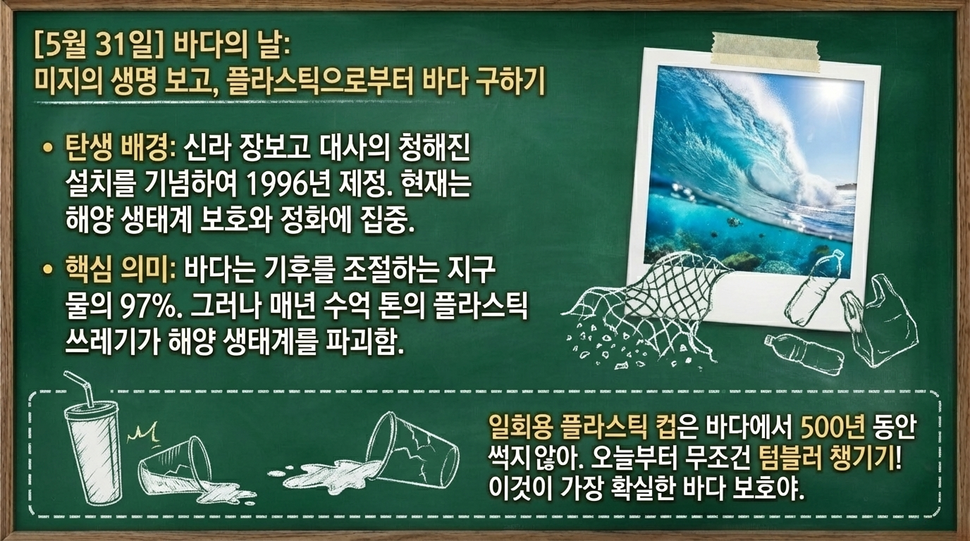
COPYRIGHT 숭신고 김강석 All rights reserved.

Slide 17
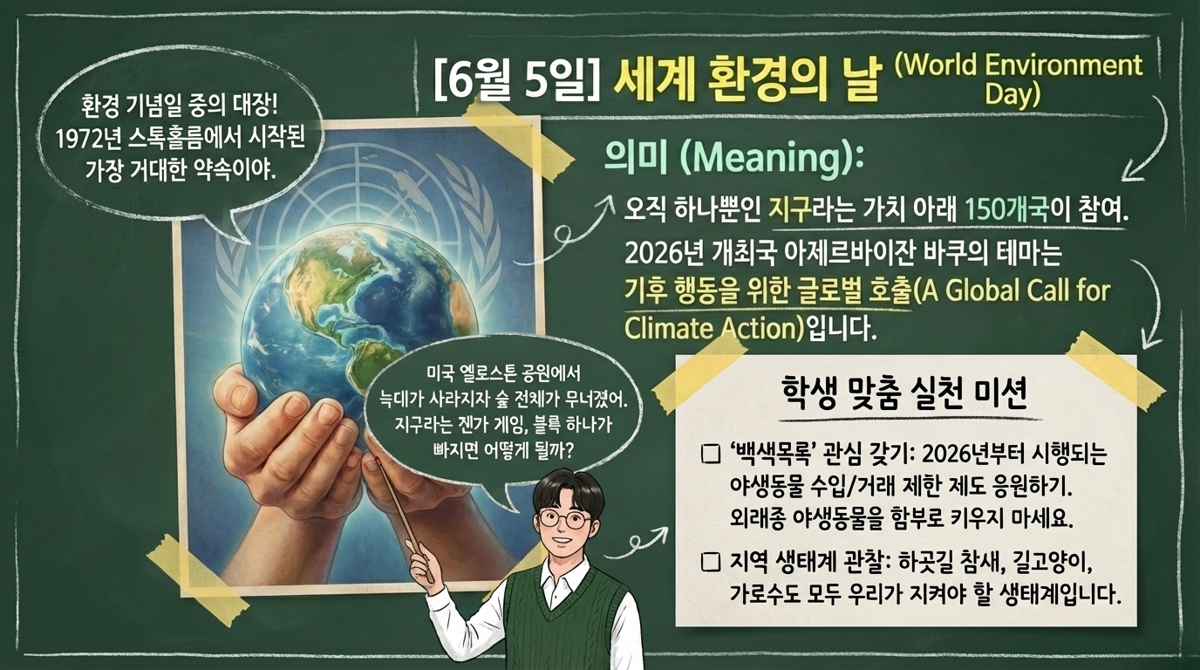
COPYRIGHT 숭신고 김강석 All rights reserved.

Slide 18
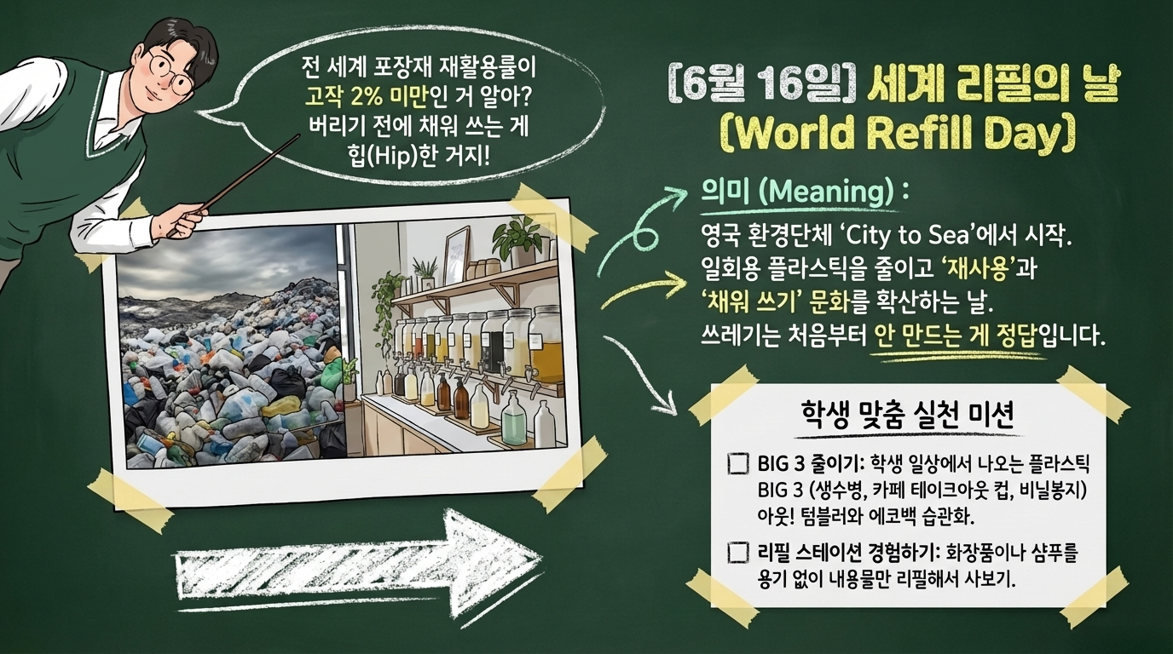
COPYRIGHT 숭신고 김강석 All rights reserved.

Slide 19
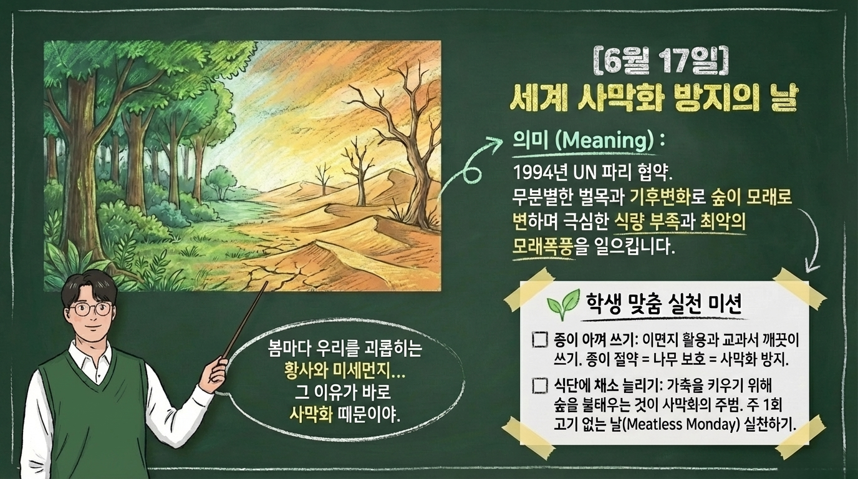
COPYRIGHT 숭신고 김강석 All rights reserved.

Slide 20
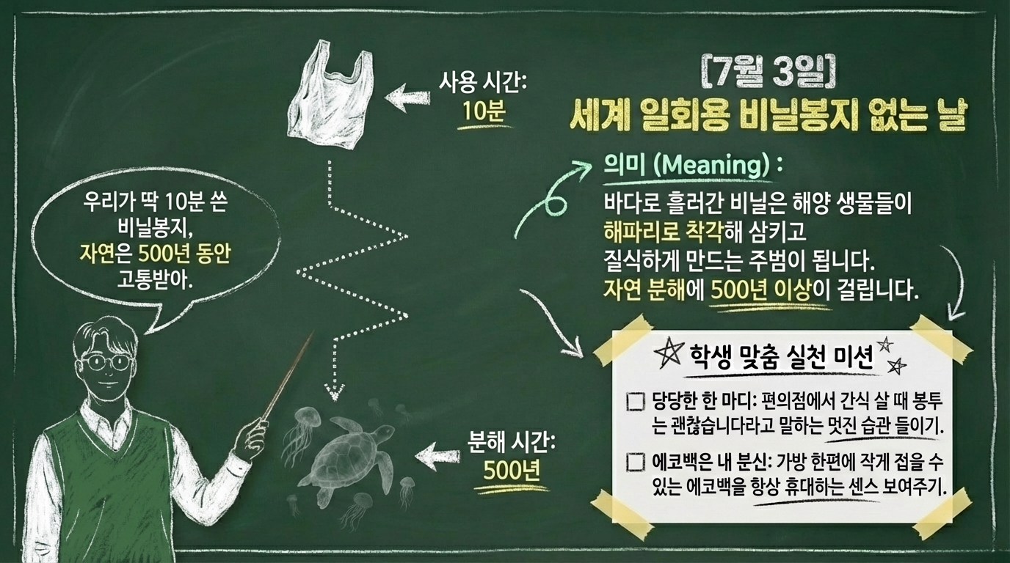
COPYRIGHT 숭신고 김강석 All rights reserved.

Slide 21
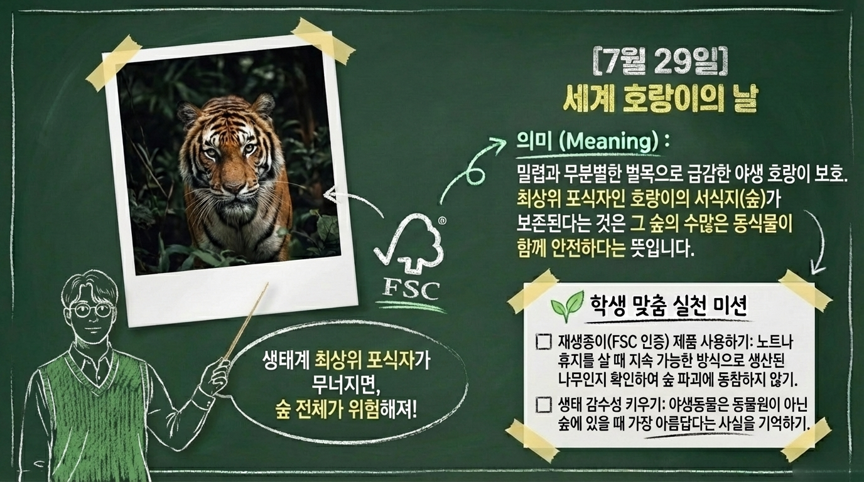
COPYRIGHT 숭신고 김강석 All rights reserved.

Slide 22
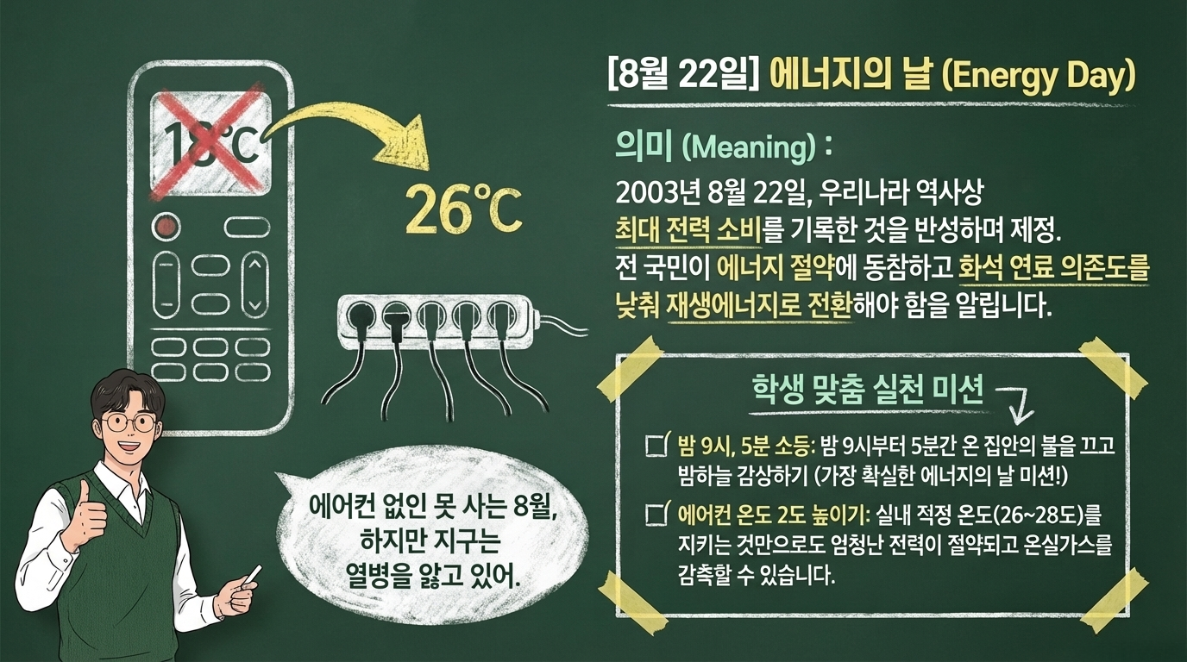
COPYRIGHT 숭신고 김강석 All rights reserved.

Slide 23
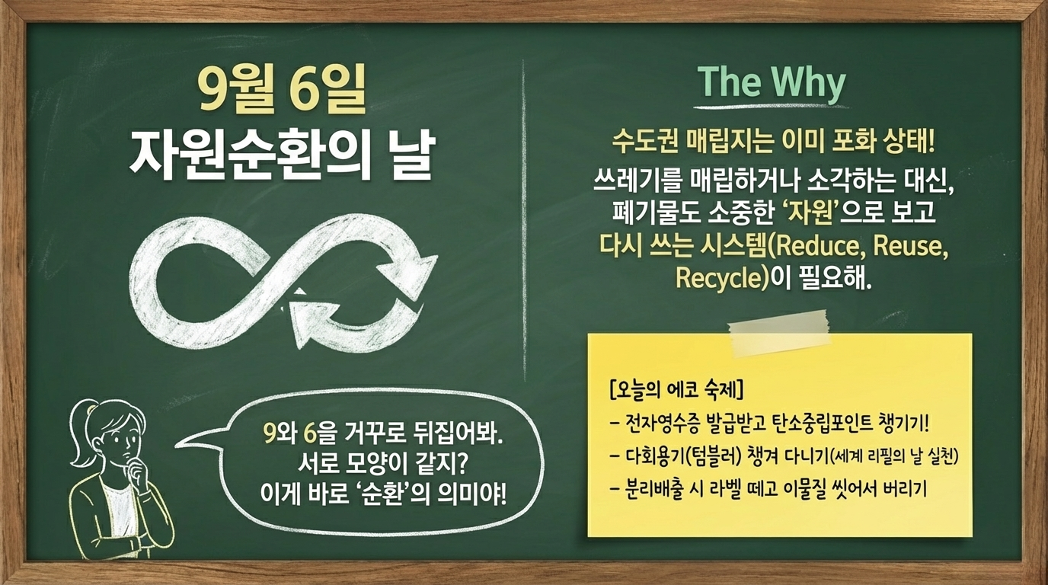
COPYRIGHT 숭신고 김강석 All rights reserved.

Slide 24
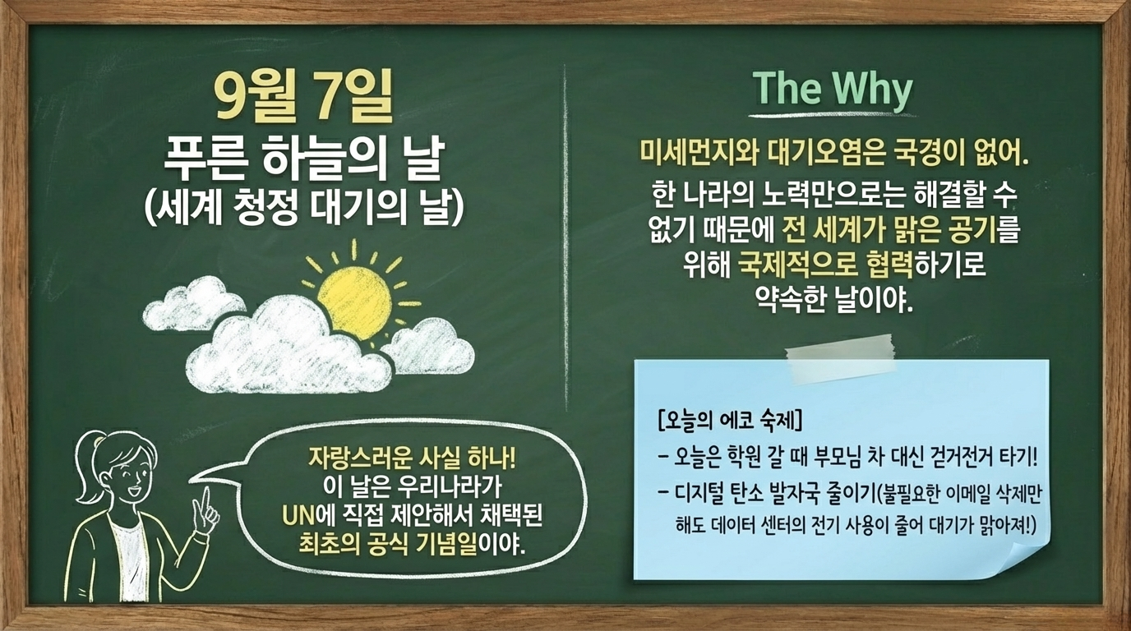
COPYRIGHT 숭신고 김강석 All rights reserved.

Slide 25
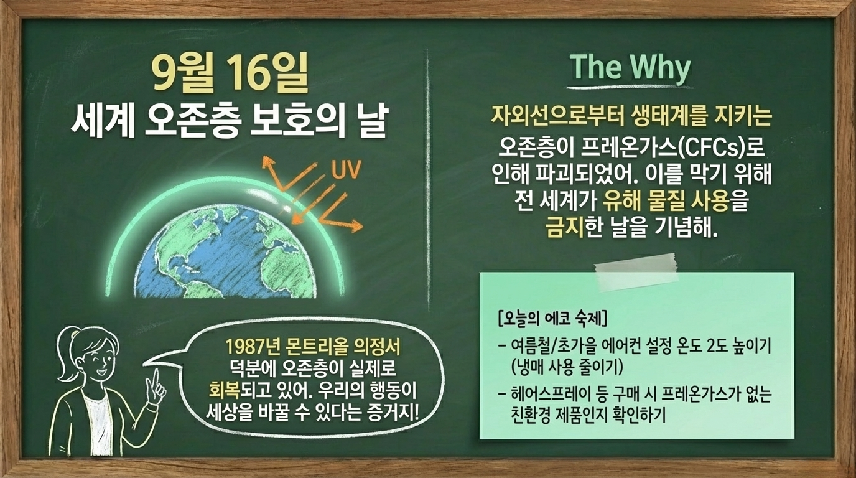
COPYRIGHT 숭신고 김강석 All rights reserved.

Slide 26
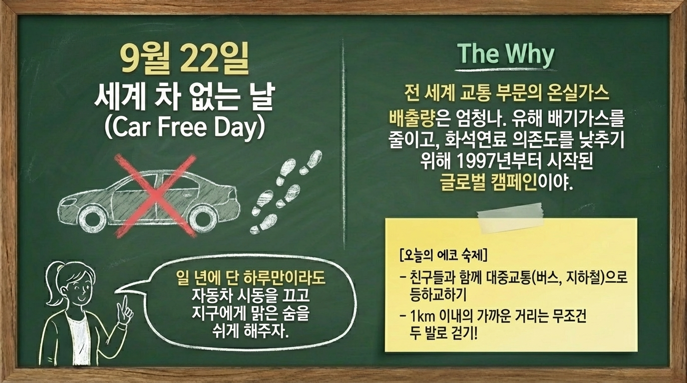
COPYRIGHT 숭신고 김강석 All rights reserved.

Slide 27
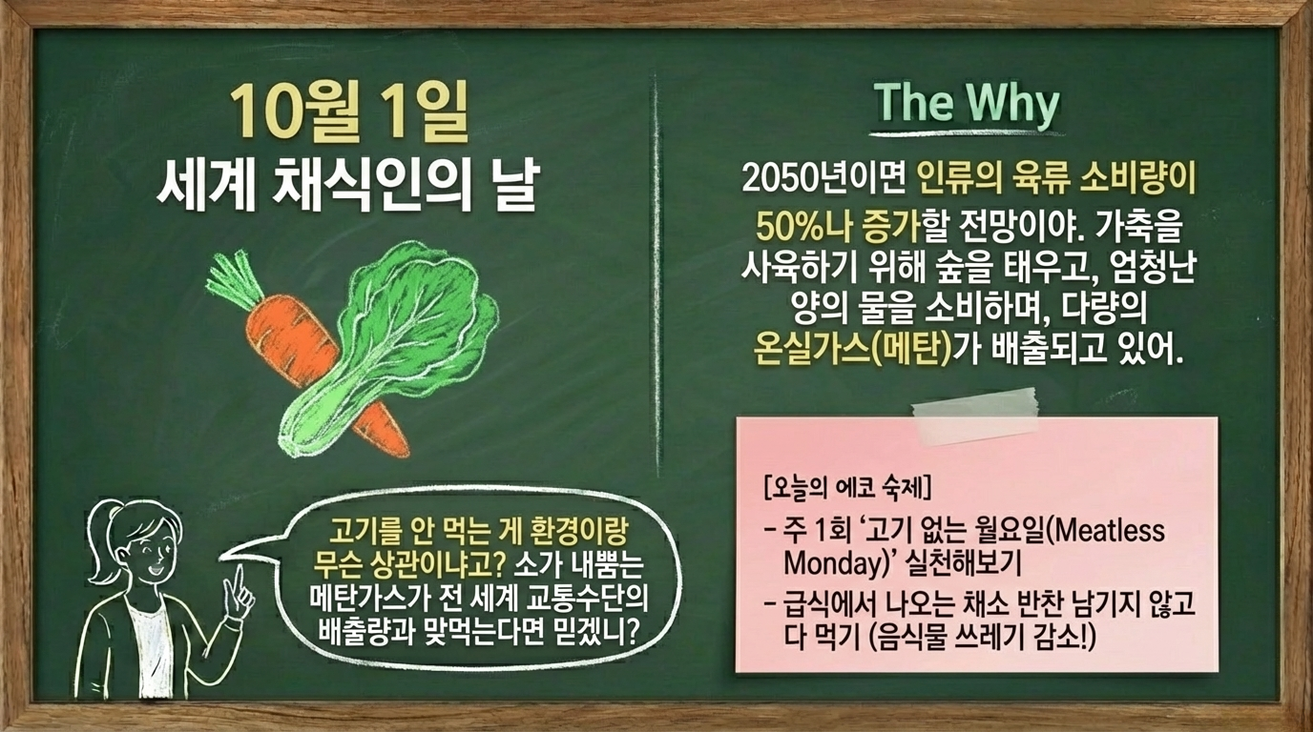
COPYRIGHT 숭신고 김강석 All rights reserved.

Slide 28
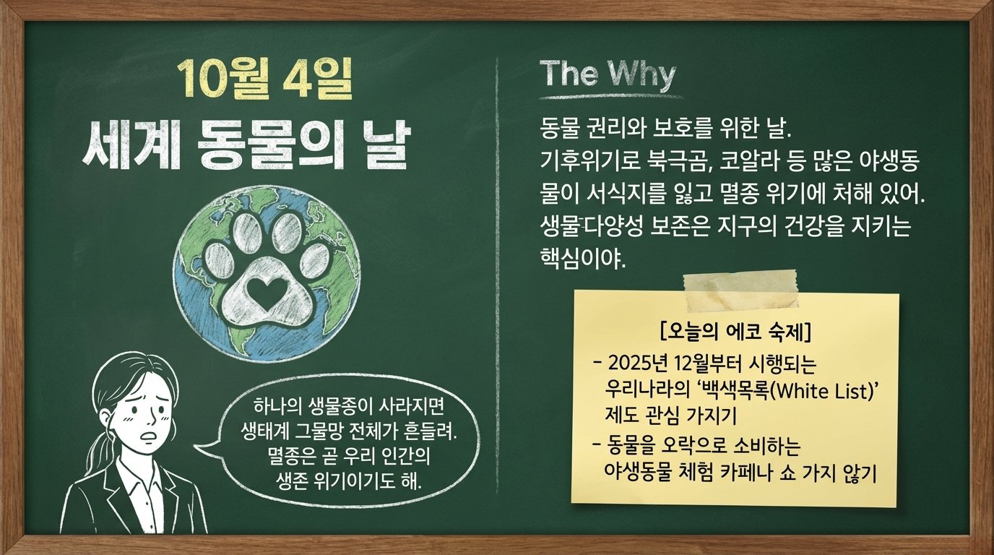
COPYRIGHT 숭신고 김강석 All rights reserved.

Slide 29
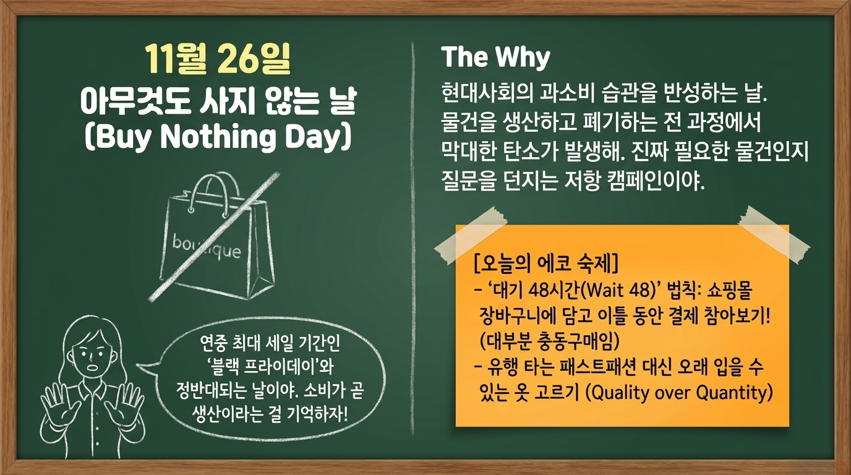
COPYRIGHT 숭신고 김강석 All rights reserved.

Slide 30
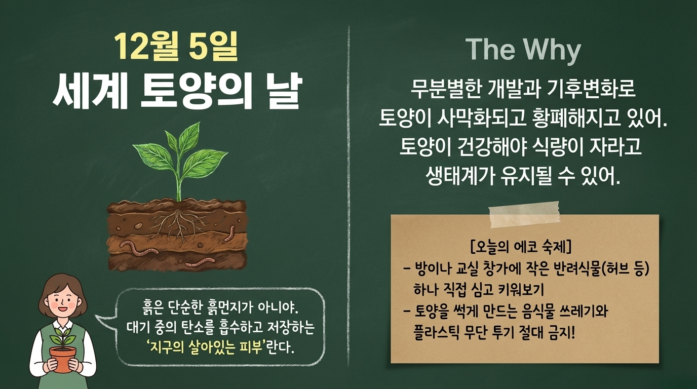

Slide 31

COPYRIGHT 숭신고 김강석 All rights reserved.

Slide 32
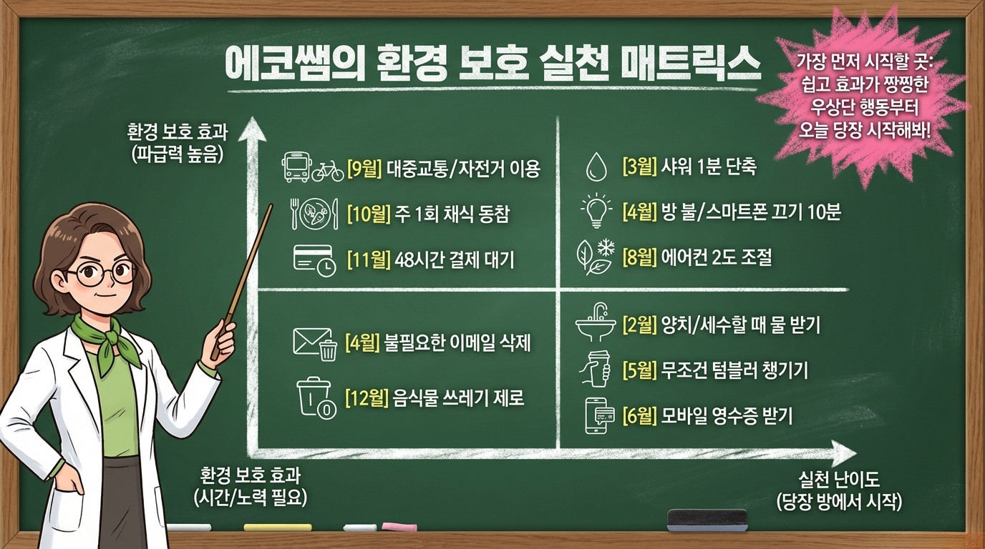
COPYRIGHT 숭신고 김강석 All rights reserved.

Slide 33
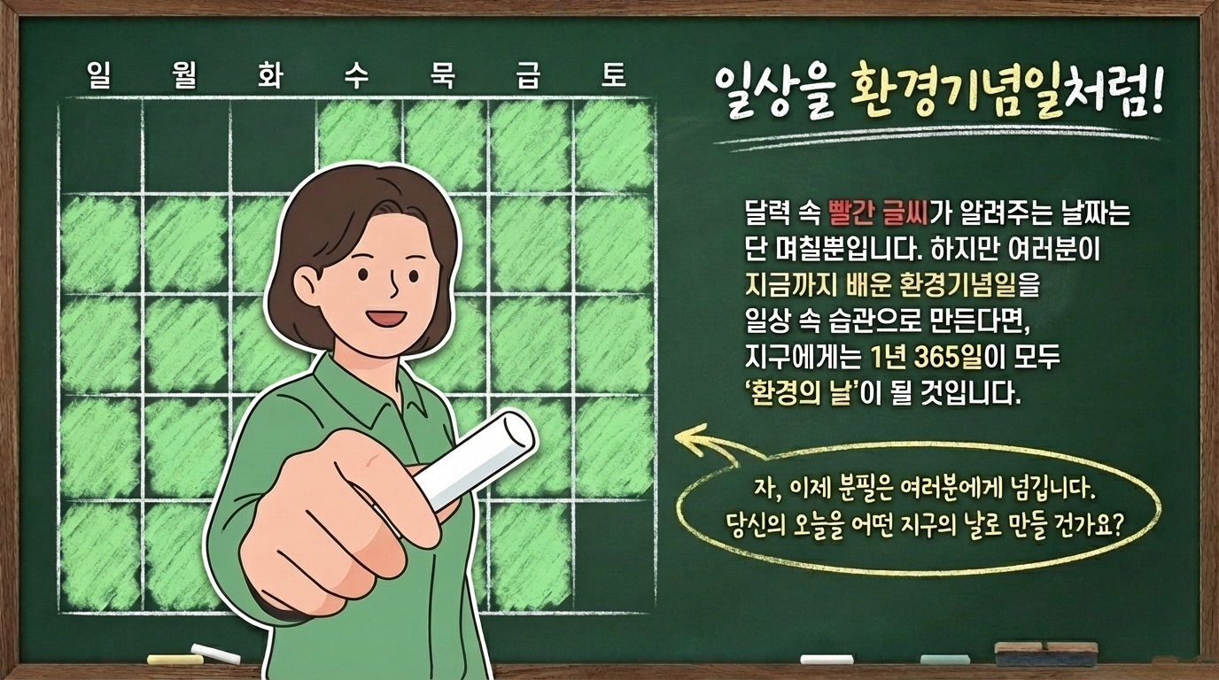
COPYRIGHT 숭신고 김강석 All rights reserved.

Slide 34

COPYRIGHT 숭신고 김강석 All rights reserved.

